Slide 1
My Rent Experience
Self introduction, Rent Experience, Ourwear, ...

Slide 2
Joel Robert Justiawan
Name: Joel Robert Justiawan
Nickname: JOELwindows7
College: Binus University, Game Application and Technology
Strengths Just to name few:
Coding
Creativity
Modeling 3D, in Blender
Weakness
Insectiphobia (fear of roach, bees, wasp, things bugs)
Not Exacta player (succ at pure math)
Hobbies:
Playing games
Develop games (right now I am developing Hexagon Engine. A Godot framework that allows you to easily build custom level, movie, serious simulations, VR, and games)
(paused) Bike
Billiard
MIDI music yay!!!
Yeah!

Slide 3
My experience at rent
What are my experience in the life of rental

Slide 4
I have never been rented something but,
Oh, I wanted to make MIDI at the highest quality ever. I know it’s Yamaha Genos
I wanted that expensive musical instrument, Yamaha Genos. Whoah!!! It costs $5000 (Rp 50 Juta / Million)!!!
How should I rent that instead? Where to find rent firm that has that? Where?
I can’t find it. Why there is No. easy to use interface, affordable, flexible timing, and whatever we wanted in this life of rent?
We couldn’t find network that meets us to renter that do that, so we need that as well.

Slide 5
Ourwear
I found solution

Slide 6
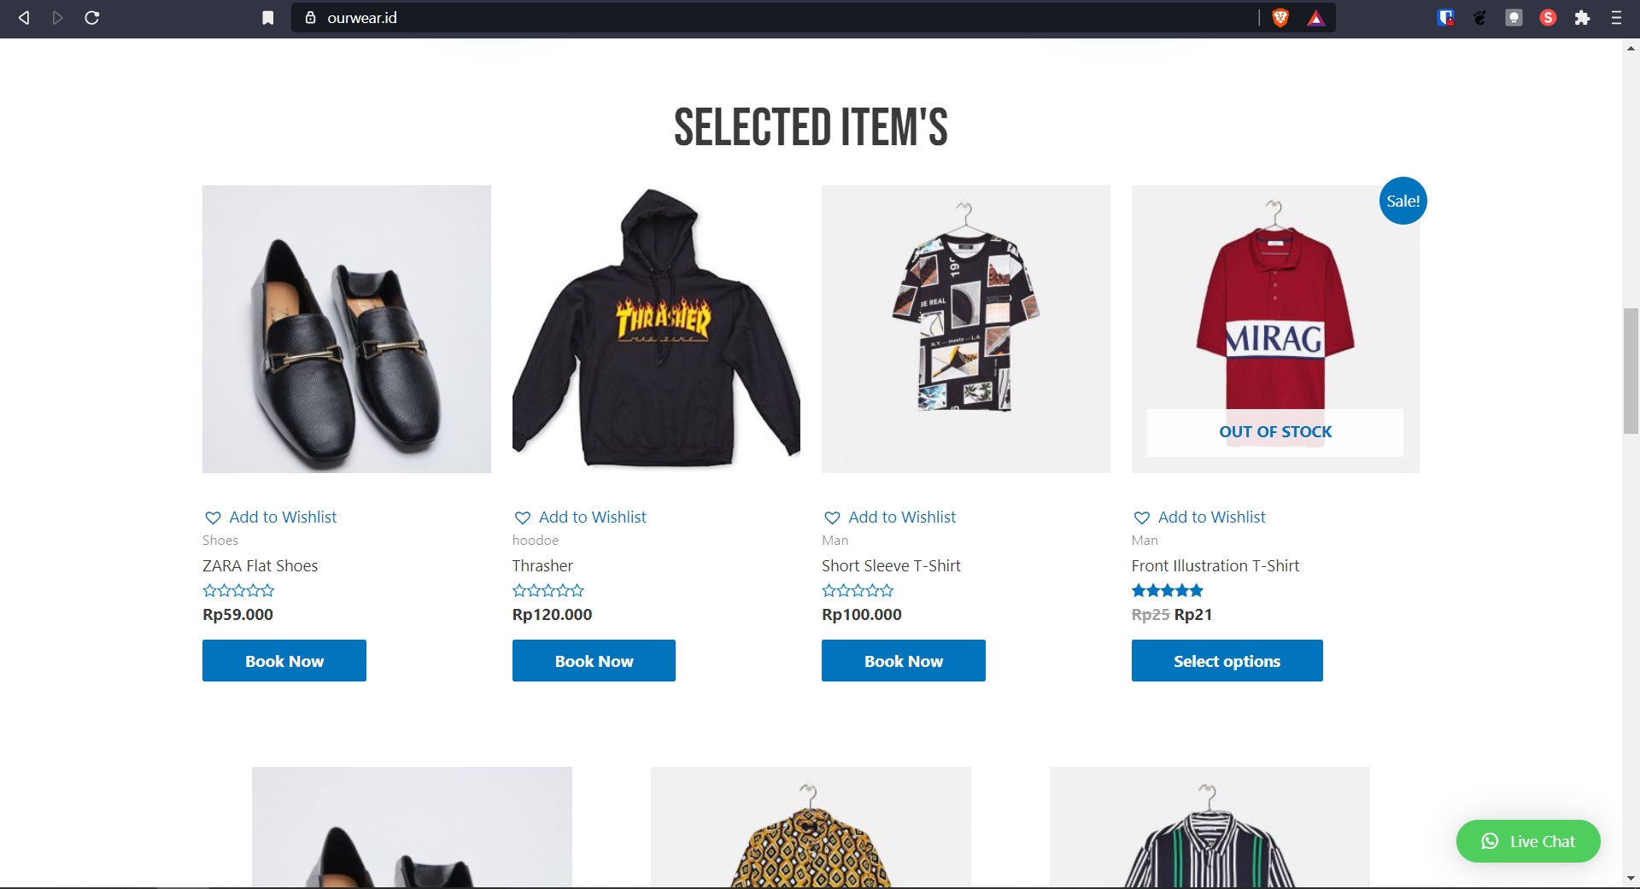
Ourwear
It’s a site where you can find various things to rent, from fashions all types, to all other stuff
You can adjust how long to rent
Find easily your favourite items you can rent
You can also put your item to rent as well, so people can hire your item yay!

Slide 7
Potential
People who wish to rent certain exotic items that is so hard to find the rent firm (such as Yamaha Genos)
Using fashion that would only be used for certain event, not a daily driver
Who needs sustainable way to handle fashion so those fashions don’t sit in the vault forever unused
etc

Slide 8
That is all for today
Thank you for your attention
Any Questions?
https://cointr.ee/joelwindows7
yeah

